Slide 1
Data Structure & Algorithms
From GeeksForGeeks
By Mohit Rawat

Slide 2


Slide 3
Introduction
Asymptotic notations are mathematical tools to represent the time complexity of algorithms for asymptotic analysis. The following 3 asymptotic notations are mostly used to represent the time complexity of algorithms:
1) Θ Notation: The theta notation bounds a functions from above and below, so it defines exact asymptotic behavior. A simple way to get Theta notation of an expression is to drop low order terms and ignore leading constants.
2) Big O Notation: The Big O notation defines an upper bound of an algorithm, it bounds a function only from above. For example, consider the case of Insertion Sort. It takes linear time in best case and quadratic time in worst case. We can safely say that the time complexity of Insertion sort is O(n^2). Note that O(n^2) also covers linear time.
3) Ω Notation: Just as Big O notation provides an asymptotic upper bound on a function, Ω notation provides an asymptotic lower bound. Ω Notation can be useful when we have lower bound on time complexity of an algorithm. The Omega notation is the least used notation among all three.

Slide 4
We can have three cases to analyze an algorithm:
Worst Case
Average Case
Best Case
Worst Case Analysis (Usually Done) In the worst case analysis, we calculate upper bound on running time of an algorithm. We must know the case that causes the maximum number of operations to be executed. For Linear Search, the worst case happens when the element to be searched (x in the above code) is not present in the array. When x is not present, the search() functions compares it with all the elements of arr[] one by one. Therefore, the worst case time complexity of linear search would be O(N), where N is the number of elements in the array. Average Case Analysis (Sometimes done) In average case analysis, we take all possible inputs and calculate computing time for all of the inputs. Sum all the calculated values and divide the sum by total number of inputs. We must know (or predict) distribution of cases. For the linear search problem, let us assume that all cases are uniformly distributed (including the case of x not being present in array). So we sum all the cases and divide the sum by (N+1).
Best Case Analysis (Bogus) : In the best case analysis, we calculate lower bound on running time of an algorithm. We must know the case that causes minimum number of operations to be executed. In the linear search problem, the best case occurs when x is present at the first location. The number of operations in the best case is constant (not dependent on N). So time complexity in the best case would be O(1)

Slide 5
Mathematics
Arithmetic Progression
A sequence of numbers is said to be in an Arithmetic progression if the difference between any two consecutive terms is always the same. In simple terms, it means that the next number in the series is calculated by adding a fixed number to the previous number in the series. For example, 2, 4, 6, 8, 10 is an AP because the difference between any two consecutive terms in the series (common difference) is same (4 - 2 = 6 - 4 = 8 - 6 = 10 - 8 = 2).
Geometric Progression
A sequence of numbers is said to be in a Geometric progression if the ratio of any two consecutive terms is always the same. In simple terms, it means that the next number in the series is calculated by multiplying a fixed number to the previous number in the series. For example, 2, 4, 8, 16 is a GP because ratio of any two consecutive terms in the series (common ratio) is the same (4 / 2 = 8 / 4 = 16 / 8 = 2).

Slide 6

Prime Numbers :-
A prime number is a whole number greater than 1, which is only divisible by 1 and itself. First few prime numbers are : 2, 3, 5, 7, 11, 13, 17, 19, 23, ........
Factorials :-
Factorial: In mathematics, the factorial of a number say N is denoted by N!. The factorial of a number is calculated by multiplying all the integers between 1 and N(both inclusive). For Example, 4! = 4 * 3 * 2 * 1 = 24.

Slide 7
Bit Magic
Bitwise Algorithms Basics
The Bitwise Algorithms are used to perform operations at bit-level or to manipulate bits in different ways. The bitwise operations are found to be much faster and are some times used to improve the efficiency of a program.
Bitwise Operators
The operators that works at Bit level are called bitwise operators. In general there are six types of Bitwise Operators as described:
& (bitwise AND) Takes two numbers as operands and does AND on every bit of two numbers. The result of AND is 1 only if both bits are 1. Suppose A = 5 and B = 3, therefore A & B = 1.

Slide 8
| (bitwise OR) Takes two numbers as operands and does OR on every bit of two numbers. The result of OR is 1 if any of the two bits is 1. Suppose A = 5 and B = 3, therefore A | B = 7.
^ (bitwise XOR) Takes two numbers as operands and does XOR on every bit of two numbers. The result of XOR is 1 if the two bits are different. Suppose A = 5 and B = 3, therefore A ^ B = 6.
<< (left shift) Takes two numbers, left shifts the bits of the first operand, the second operand decides the number of places to shift.
>> (right shift) Takes two numbers, right shifts the bits of the first operand, the second operand decides the number of places to shift.
~ (bitwise NOT) Takes one number and inverts all bits of it. Suppose A = 5, therefore ~A = 2.

Slide 9
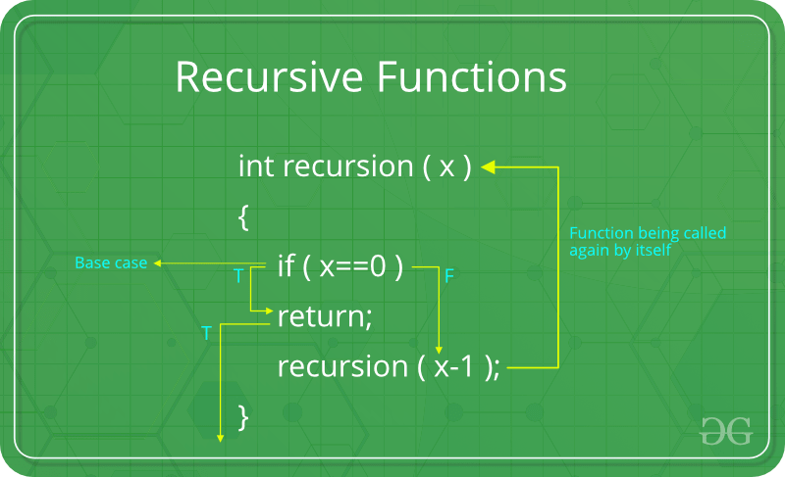
Recursion
What is Recursion?
The process in which a function calls itself directly or indirectly is called recursion and the corresponding function is called as recursive function. Using recursive algorithm, certain problems can be solved quite easily. Examples of such problems are Towers of Hanoi (TOH), Inorder/Preorder/Postorder Tree Traversals, DFS of Graph, etc.

Slide 10
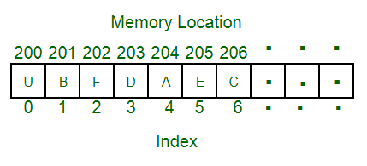
Array
An array is a collection of items of the same data type stored at contiguous memory locations. This makes it easier to calculate the position of each element by simply adding an offset to a base value, i.e., the memory location of the first element of the array (generally denoted by the name of the array). For simplicity, we can think of an array as a fleet of stairs where on each step a value is placed (let’s say one of your friends). Here, you can identify the location of any of your friends by simply knowing the count of the step that they are on. Remember: “Location of the next index depends on the data type that we use”.

Slide 11
Searching in an Array
Searching for an element in an array means to check if a given element is present in the array or not. This can be done by accessing elements of the array one by one starting from the first element and checking whether any of the elements matches with the given element.
Insertion in Arrays:-
Given an array of a given size. The task is to insert a new element in this array. There are two possible ways of inserting elements in an array:
Insert elements at the end of the array.
Insert element at any given index in the array.
Deletion in Arrays:-
To delete a given element from an array, we will have to first search the element in the array. If the element is present in the array then delete operation is performed for the element otherwise the user is notified that the array does not contains the given element

Slide 12
Hashing
Hashing is a method of storing and retrieving data from a database efficiently. Suppose that we want to design a system for storing employee records keyed using phone numbers. And we want the following queries to be performed efficiently:
Insert a phone number and the corresponding information.
Search a phone number and fetch the information.
Delete a phone number and the related information.

Slide 13
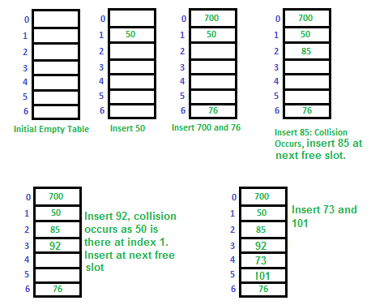
Hash Function: A function that converts a given big phone number to a small practical integer value. The mapped integer value is used as an index in the hash table. In simple terms, a hash function maps a big number or string to a small integer that can be used as an index in the hash table. A good hash function should have following properties:
It should be efficiently computable.
It should uniformly distribute the keys (Each table position be equally likely for each key).

Slide 14
Hashing in C++ using STL
Hashing in C++ can be implemented using different containers present in STL as per the requirement. Usually, STL offers the below-mentioned containers for implementing hashing:
set
unordered_set
map
unordered_map

Slide 15
String
Strings are defined as a stream of characters. Strings are used to represent text and are generally represented by enclosing text within quotes as: "This is a sample string!". Different programming languages have different ways of declaring and using Strings. We will learn to implement strings in C/C++ and Java. Strings in C/C++
In C/C++, Strings are defined as an array of characters. The difference between a character array and a string is that the string is terminated with a special character ‘\0’.

Slide 16
// C/C++ program to illustrate string
#include<bits/stdc++.h>
int main()
{
// declare and initialize string
char str[] = “Mohit Rawat";
// print string
printf("%s",str);
return 0;
}

Slide 17
Linked List
Linked Lists are linear or sequential data structures in which elements are stored at non-contiguous memory locations and are linked to each other using pointers.
Like arrays, linked lists are also linear data structures but in linked lists elements are not stored at contiguous memory locations. They can be stored anywhere in the memory but for sequential access, the nodes are linked to each other using pointers. Each element in a linked list consists of two parts:
Data: This part stores the data value of the node. That is the information to be stored at the current node.
Next Pointer: This is the pointer variable or any other variable which stores the address of the next node in the memory.

Slide 18
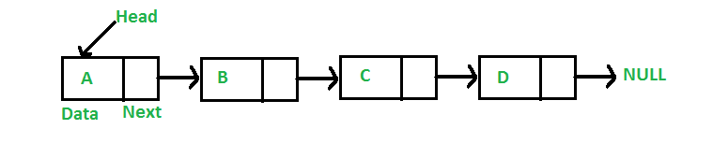
Advantages of Linked Lists over Arrays: Arrays can be used to store linear data of similar types, but arrays have the following limitations:
The size of the arrays is fixed, so we must know the upper limit on the number of elements in advance. Also, generally, the allocated memory is equal to the upper limit irrespective of the usage. On the other hand, linked lists are dynamic and the size of the linked list can be incremented or decremented during runtime.
Inserting a new element in an array of elements is expensive, because a room has to be created for the new elements, and to create room, existing elements have to shift.

Slide 19
Stack
The Stack is a linear data structure, which follows a particular order in which the operations are performed. The order may be LIFO(Last In First Out) or FILO(First In Last Out).
The LIFO order says that the element which is inserted at the last in the Stack will be the first one to be removed. In LIFO order, the insertion takes place at the rear end of the stack and deletion occurs at the front of the stack.
The FILO order says that the element which is inserted at the first in the Stack will be the last one to be removed. In FILO order, the insertion takes place at the rear end of the stack and deletion occurs at the front of the stack.

Slide 20
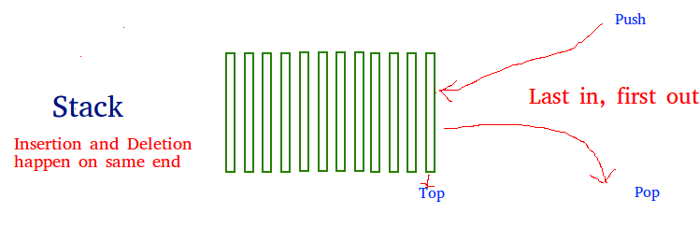
Mainly, the following three basic operations are performed in the stack:
Push: Adds an item in the stack. If the stack is full, then it is said to be an Overflow condition.
Pop: Removes an item from the stack. The items are popped in the reversed order in which they were pushed. If the stack is empty, then it is said to be an Underflow condition.
Peek or Top: Returns the top element of the stack.

Slide 21
Queue
Like Stack data structure, Queue is also a linear data structure that follows a particular order in which the operations are performed. The order is First In First Out (FIFO), which means that the element that is inserted first in the queue will be the first one to be removed from the queue. A good example of queue is any queue of consumers for a resource where the consumer who came first is served first. The difference between stacks and queues is in removing. In a stack, we remove the most recently added item; whereas, in a queue, we remove the least recently added item. Operations on Queue: Mainly the following four basic operations are performed on queue:
Enqueue: Adds an item to the queue. If the queue is full, then it is said to be an Overflow condition.
Dequeue: Removes an item from the queue. The items are popped in the same order in which they are pushed. If the queue is empty, then it is said to be an Underflow condition.
Front: Get the front item from queue.
Rear: Get the last item from queue.

Slide 22
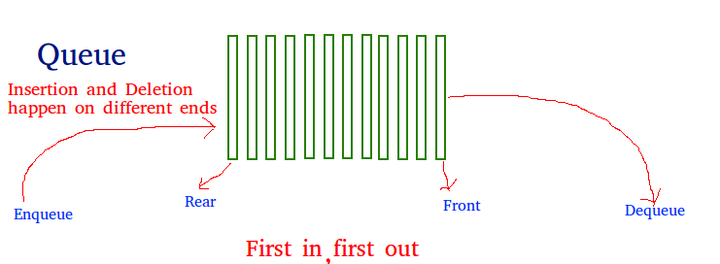

Slide 23
Deque
Deque or Double Ended Queue is a generalized version of Queue data structure that allows insert and delete at both ends.
Operations on Deque: Mainly the following four basic operations are performed on queue:
insertFront(): Adds an item at the front of Deque. insertLast(): Adds an item at the rear of Deque. deleteFront(): Deletes an item from front of Deque. deleteLast(): Deletes an item from rear of Deque.
In addition to above operations, following operations are also supported getFront(): Gets the front item from queue. getRear(): Gets the last item from queue. isEmpty(): Checks whether Deque is empty or not. isFull(): Checks whether Deque is full or not.

Slide 24
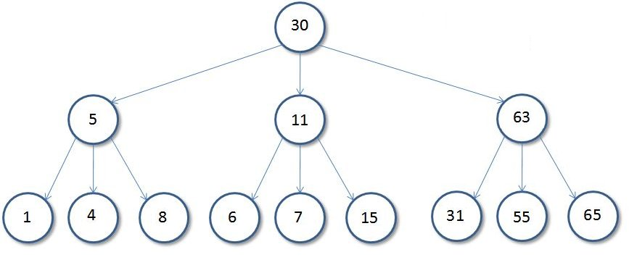
Tree
A Tree is a non-linear data structure where each node is connected to a number of nodes with the help of pointers or references.

Slide 25
Basic Tree Terminologies:
Root: The root of a tree is the first node of the tree. In the above image, the root node is the node 30.
Edge: An edge is a link connecting any two nodes in the tree. For example, in the above image there is an edge between node 11 and 6.
Siblings: The children nodes of same parent are called siblings. That is, the nodes with same parent are called siblings. In the above tree, nodes 5, 11, and 63 are siblings.
Leaf Node: A node is said to be the leaf node if it has no children. In the above tree, node 15 is one of the leaf nodes.
Height of a Tree: Height of a tree is defined as the total number of levels in the tree or the length of the path from the root node to the node present at the last level. The above tree is of height 2.

Slide 26
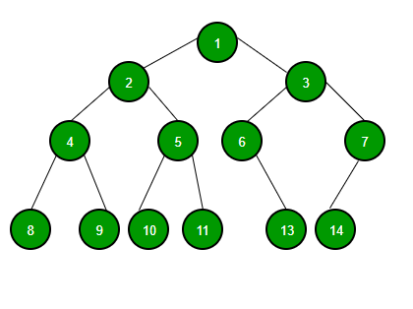
Binary Tree
A Tree is said to be a Binary Tree if all of its nodes have atmost 2 children. That is, all of its node can have either no child, 1 child, or 2 child nodes.

Slide 27
Heap
A Heap is a Tree-based data structure, which satisfies the below properties:
A Heap is a complete tree (All levels are completely filled except possibly the last level and the last level has all keys as left as possible).
A Heap is either Min Heap or Max Heap. In a Min-Heap, the key at root must be minimum among all keys present in the Binary Heap. The same property must be recursively true for all nodes in the Tree. Max Heap is similar to MinHeap.

Slide 28
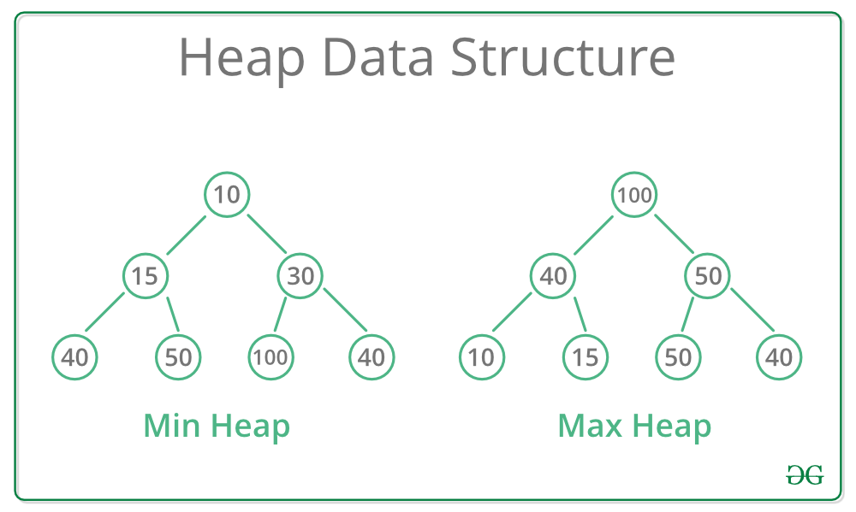
Binary Heap: A Binary Heap is a heap where each node can have at most two children. In other words, a Binary Heap is a complete Binary Tree satisfying the above-mentioned properties.

Slide 29
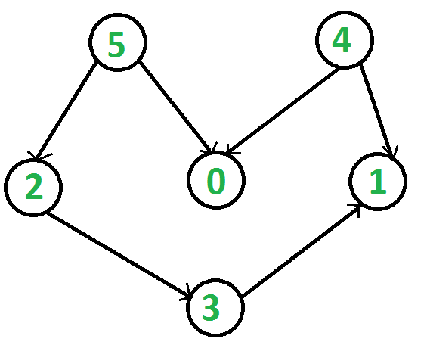
Graph
A Graph is a data structure that consists of the following two components:
A finite set of vertices also called nodes.
A finite set of ordered pair of the form (u, v) called as edge. The pair is ordered because (u, v) is not the same as (v, u) in case of a directed graph(digraph). The pair of the form (u, v) indicates that there is an edge from vertex u to vertex v. The edges may contain weight/value/cost.

Slide 30
Thank You

